Slide 1
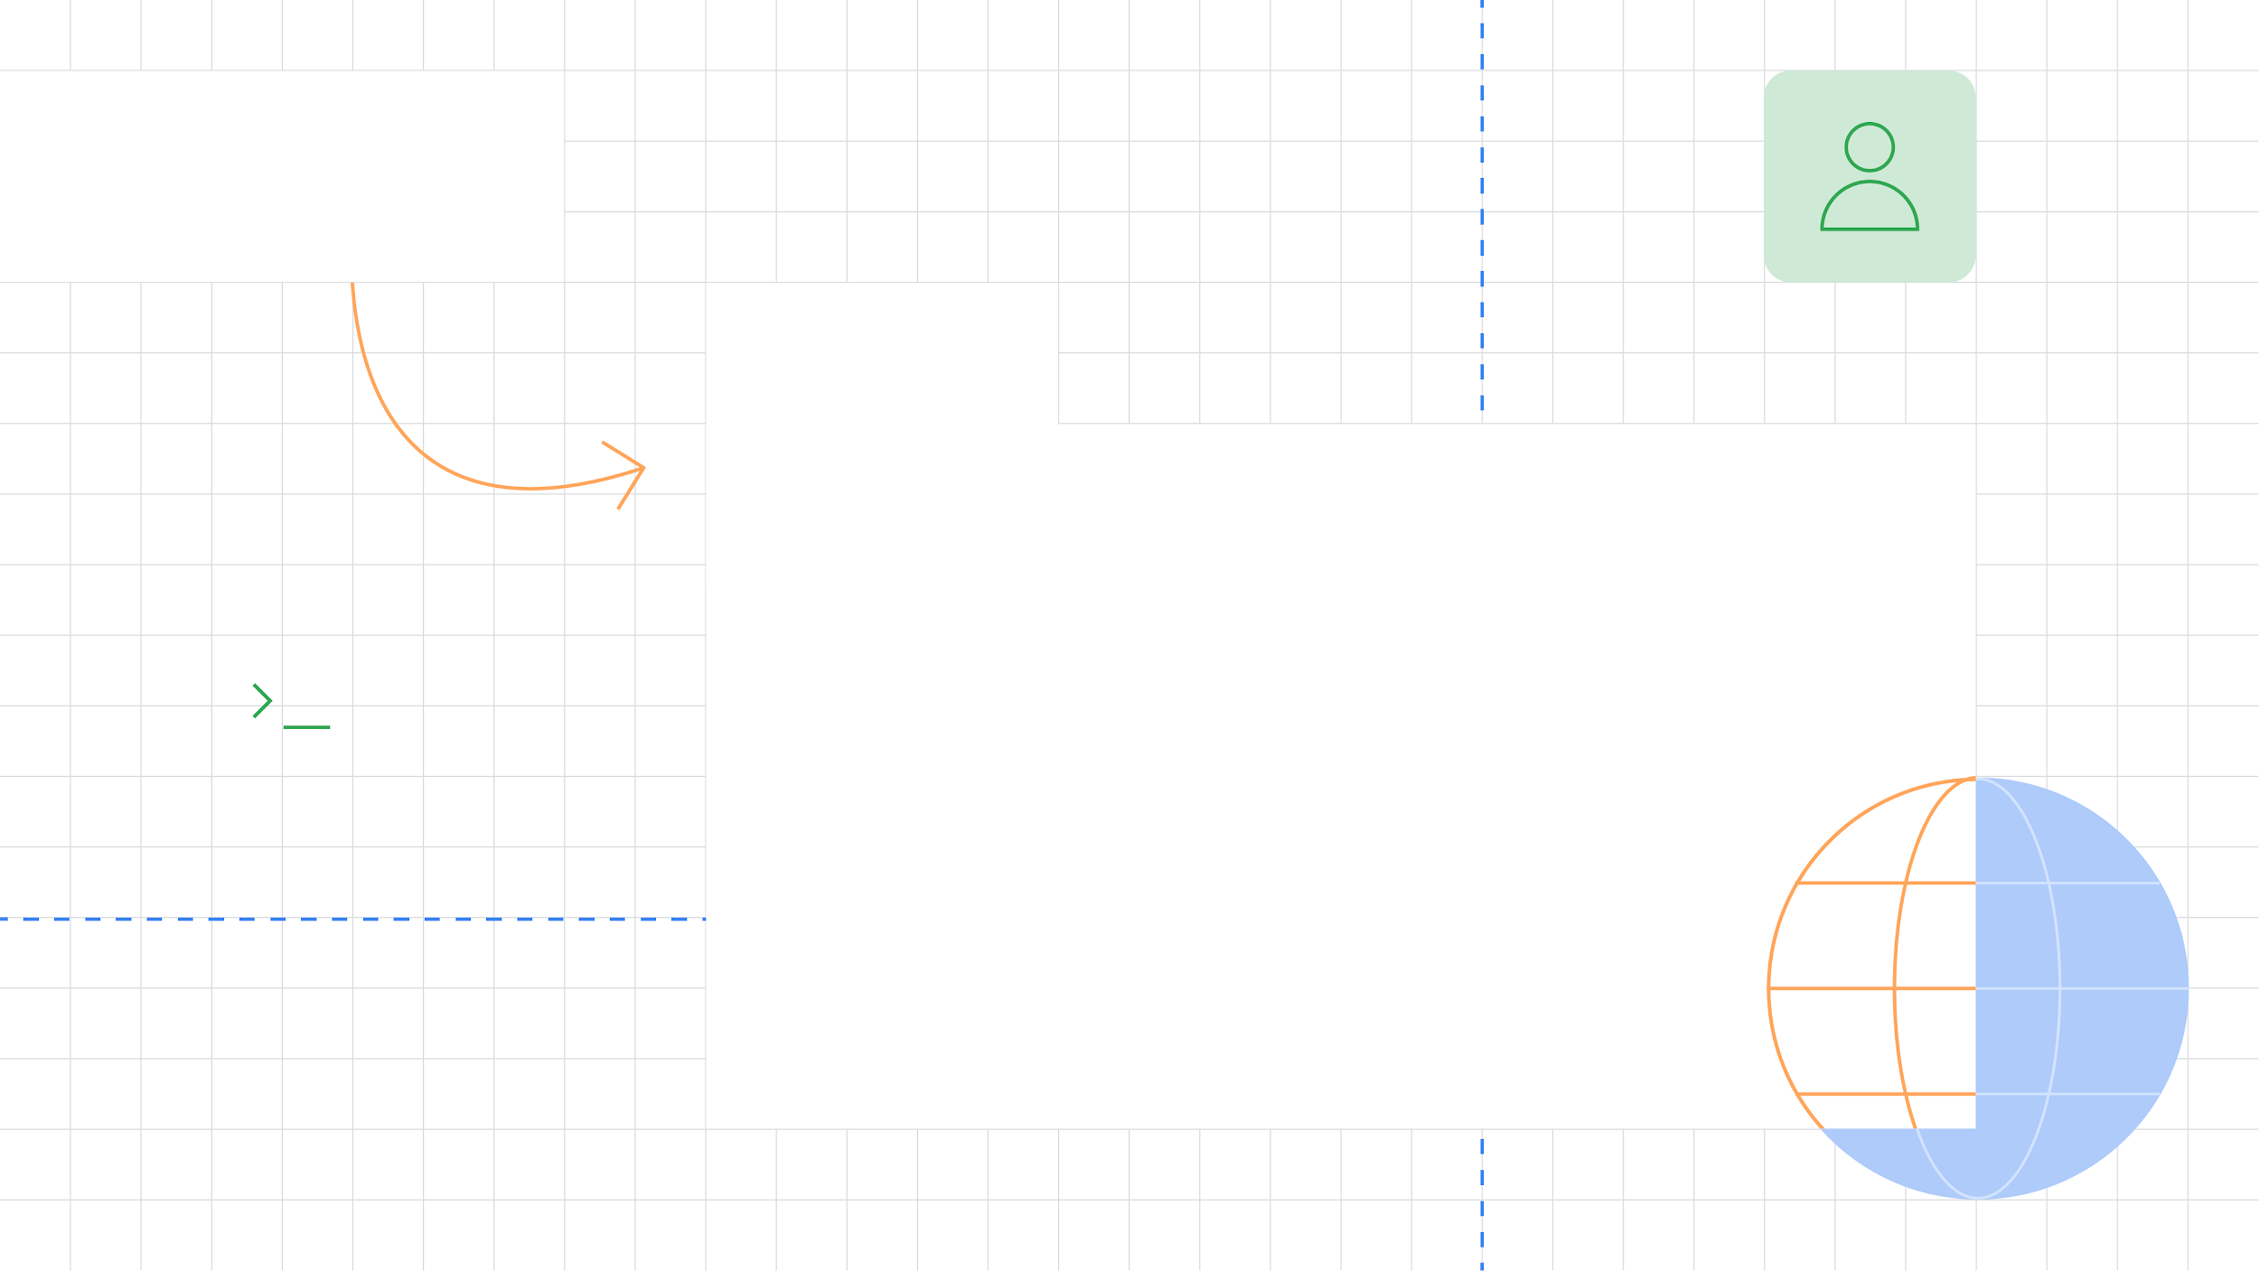


Exploring Jetpack Compose
Diving into the framework

Slide 2


Contents
Things we’ll talk about
What is Compose?
Compose Basics
State handling
Complex composables
Advanced Compose

Slide 3
What is Jetpack Compose?

Slide 4
What is Jetpack Compose?
The idea behind the framework
Jetpack Compose is a new and fully declarative way to design and render Android user interfaces.
It relies on composable functions, modifiers and reacting to state changes to display beautiful, material-design-inspired UI using Kotlin!

Slide 5
Well how is this better?

Slide 6
Straightforward benefits
Things you get right off the bat
You no longer have to write XML to produce the UI spec you’re given!
You can have both business logic & the UI in Kotlin!
New, updated and decoupled framework where everything is a function!
Just call setContent() and that’s it!

Slide 7
Less talk more code! :]

Slide 8
Composable functions

Slide 9
@Composable
fun MyComposable() {
Text(text = "Compose is so awesome!")
}

Slide 10
@Composable
fun MyComposable() {
Text(text = "Compose is so awesome!")
}

Slide 11
@Composable
fun MyComposable() {
Text(text = "Compose is so awesome!")
}

Slide 12
@Composable
fun MyComposable() {
Text(text = "Compose is so awesome!")
}

Slide 13
@Composable
fun MyComposable(text: String) {
Text(text = text)
}

Slide 14
Basic Composables

Slide 15
Text(text = "Compose is so awesome!")
Button(onClick = { }) {
// content
}
Icon(imageVector = vectorResource(id =))
Image(bitmap = imageResource(id =))
TextField(value = "", onValueChange = { })
FloatingActionButton(onClick = { }) {
// content
}

Slide 16
Text(text = "Compose is so awesome!")
Button(onClick = { }) {
// content
}
Icon(imageVector = vectorResource(id =))
Image(bitmap = imageResource(id =))
TextField(value = "", onValueChange = { })
FloatingActionButton(onClick = { }) {
// content
}

Slide 17
Previewing compose elements

Slide 18
Previews without running the app
Android Studio features for Compose
Jetpack Compose lets you add @Preview to all your composables, to see what the elements would look like when you run the app.
Without running the app.
You can also interact with the elements - like clicking it.

Slide 19
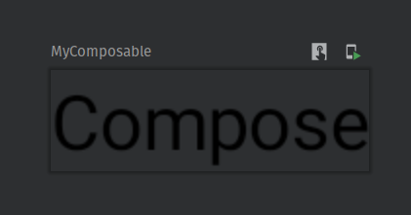
@Preview
@Composable
fun MyComposable(text: String = ”Compose”) {
Text(text = text)
}

Slide 20
@Preview
@Composable
fun MyComposable(text: String = ”Compose”) {
Text(text = text)
}

Slide 21
Compose Containers/Layouts

Slide 22
@Composable
@Preview
fun MyComposable(text: String = "Compose") {
Box {
Text(text = text)
Text(text = text)
Text(text = text)
}
}

Slide 23
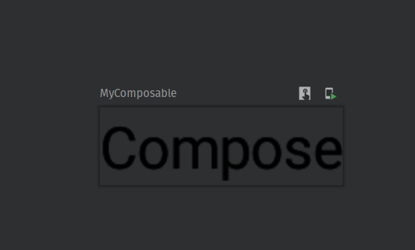

Slide 24
@Composable
@Preview
fun MyComposable(text: String = "Compose") {
Row {
Text(text = text)
Text(text = text)
Text(text = text)
}
}

Slide 25
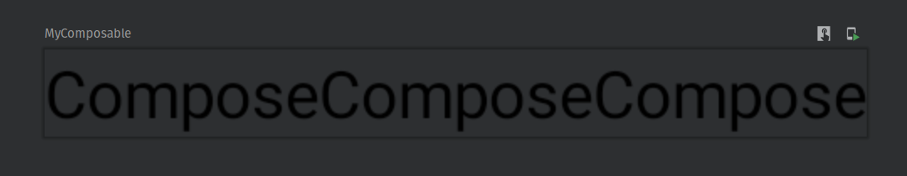

Slide 26
@Composable
@Preview
fun MyComposable(text: String = "Compose") {
Column {
Text(text = text)
Text(text = text)
Text(text = text)
}
}

Slide 27
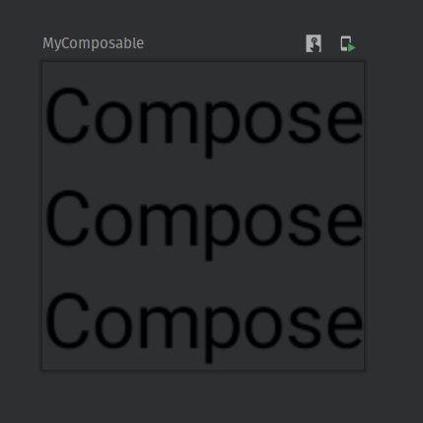

Slide 28
Complex/Beautiful Composables

Slide 29
Building Complex UI
Styling & combining composables
You can style specific UI components through modifiers, or you can apply themes across entire Compose trees.
Modifiers are styling functions you can chain & that respect the chain order. Background, alignment, size, padding, clickability...

Slide 30

TopBar
Content
Scaffold
FAB
BottomBar

Slide 31
@Composable
fun MainScreen() {
Scaffold(
topBar = { MainTopBar() },
bottomBar = {
BottomNavigation {
BottomNavigationItem(icon, label, selected, onClick),
BottomNavigationItem(icon, label, selected, onClick),
BottomNavigationItem(icon, label, selected, onClick)
}
},
floatingActionButton = { MainScreenFloatingAction() }
) { // content
MainScreenContent()
}
}

Slide 32

Row - Content | Image
LazyRow - 5 Icons
Row - Text | Rating Icons
Column - Text | Rating | Description

Slide 33
@Composable
fun BookReviewItem(
bookReview: BookReview,
onItemClick: (BookReview) -> Unit,
onLongItemTap: (BookReview) -> Unit
) {
Card(
elevation = 8.dp,
border = BorderStroke(1.dp, MaterialTheme.colors.primary),
shape = RoundedCornerShape(16.dp),
modifier = Modifier
.wrapContentHeight()
.padding(16.dp)
.combinedClickable(
onClick = { onItemClick(bookReview) },
indication = null,
onLongClick = { onLongItemTap(bookReview) }
)
) {}
}

Slide 34
Row(modifier = Modifier.fillMaxSize()) {
Spacer(modifier = Modifier.size(16.dp))
Column(
modifier = Modifier
.weight(0.6f)
.fillMaxHeight()
) {
Spacer(modifier = Modifier.height(16.dp))
Text(
text = bookReview.book.name,
color = MaterialTheme.colors.primary,
fontSize = 18.sp,
fontWeight = FontWeight.Bold
)
Spacer(modifier = Modifier.height(8.dp))
...
Book Title

Slide 35
Row {
Text(
text = stringResource(id = R.string.rating_text),
color = MaterialTheme.colors.onPrimary
)
RatingBar(
range = 1..5,
currentRating = bookReview.review.rating,
isSelectable = false,
isLargeRating = false
)
}
Spacer(modifier = Modifier.height(8.dp))
Rating

Slide 36
... Text(
text = bookReview.review.notes,
fontSize = 12.sp,
modifier = Modifier.fillMaxSize(),
overflow = TextOverflow.Ellipsis,
fontStyle = FontStyle.Italic,
maxLines = 4,
color = MaterialTheme.colors.onPrimary
)
Spacer(modifier = Modifier.height(16.dp))
}
Description
Column end

Slide 37
Spacer(modifier = Modifier.width(16.dp))
Card(
modifier = Modifier.weight(0.4f),
shape = RoundedCornerShape(
topRight = 16.dp,
topLeft = 16.dp,
bottomLeft = 0.dp,
bottomRight = 16.dp
),
elevation = 16.dp
) {
Image(
painter =
rememberImagePainter(bookReview.review.imageUrl),
contentScale = ContentScale.FillWidth
)
}
}
}
}
Image Card Shape
Coil powered Image

Slide 38
Row - Content | Image
LazyRow- 5 Icons
Row - Text | Rating Icons
Column - Text | Rating | Description

Slide 39
TopBar
Content
Scaffold
FAB
BottomBar

Slide 40
Building Lists/Dynamic Composables

Slide 41
Building Lists
Dynamic Composables are just Composables
Building lists and dynamic components is as easy as calling a for-loop or using one of the predefined “lazy components”.
LazyColumn - building vertical lists.
LazyRow - building horizontal lists.

Slide 42
@Composable
fun BookReviewsList(
bookReviews: List<BookReview>,
onItemClick: (BookReview) -> Unit,
onLongItemTap: (BookReview) -> Unit
) {
LazyColumn {
items(bookReviews) { bookReview ->
BookReviewItem(bookReview, onItemClick, onLongItemTap)
}
}
}

Slide 43
@Composable
@Preview
fun MyComposable(items: List<Data>) {
for (item in items) {
MyItem(item)
}
}

Slide 44
Adding state

Slide 45
State Handling
The most important thing about UI
Compose allows you to easily listen to and remember the state of your components.
Using remember() you create State objects that store data within the component lifecycle.
It’s also important to know that Compose doesn’t work without state - forces declarative programming.

Slide 46
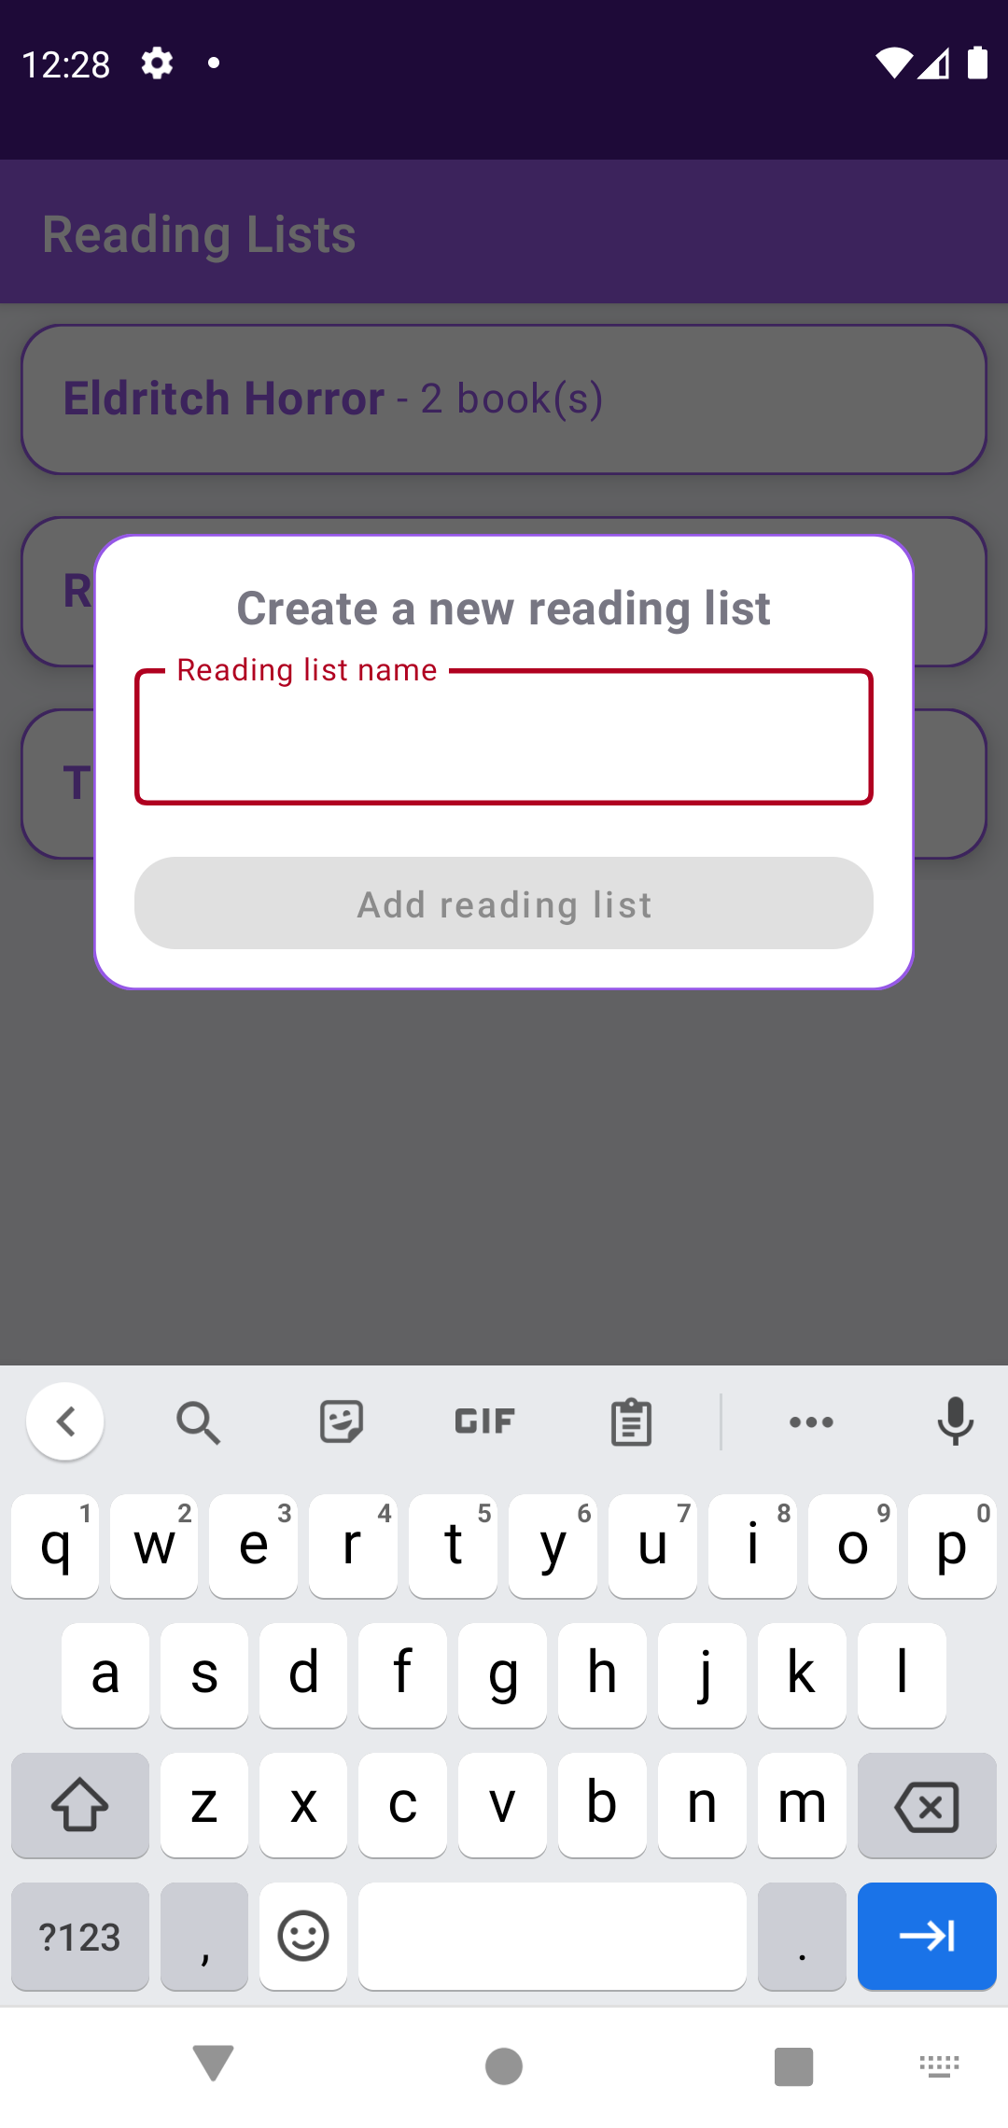
Typing

Slide 47
@Composable
fun AddReadingList(
onAddList: (String) -> Unit,
onDismiss: () -> Unit
) {
val inputState = remember { mutableStateOf("") }
}

Slide 48
@Composable
fun AddReadingList(
onAddList: (String) -> Unit,
onDismiss: () -> Unit
) {
val inputState = remember { mutableStateOf("") }
....
InputField(
value = inputState.value,
isInputValid = inputState.value.isNotEmpty(),
onStateChanged = { newValue -> inputState.value = newValue }
)
ActionButton(
isEnabled = inputState.value.isNotEmpty(),
onClick = { onAddList(inputState.value) }
)
}
}

Slide 49
@Composable
fun AddReadingList(
onAddList: (String) -> Unit,
onDismiss: () -> Unit
) {
val inputState = remember { mutableStateOf("") }
....
InputField(
value = inputState.value,
isInputValid = inputState.value.isNotEmpty(),
onStateChanged = { newValue -> inputState.value = newValue } // state change
)
ActionButton(
isEnabled = inputState.value.isNotEmpty(),
onClick = { onAddList(inputState.value) }
)
}
}

Slide 50
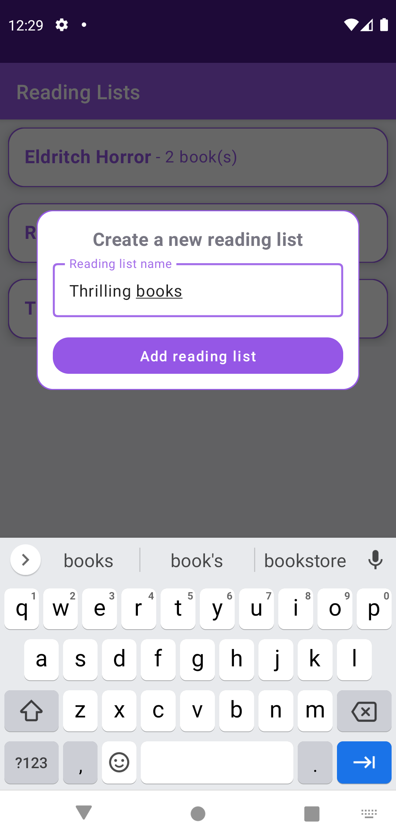
Typing

Slide 51
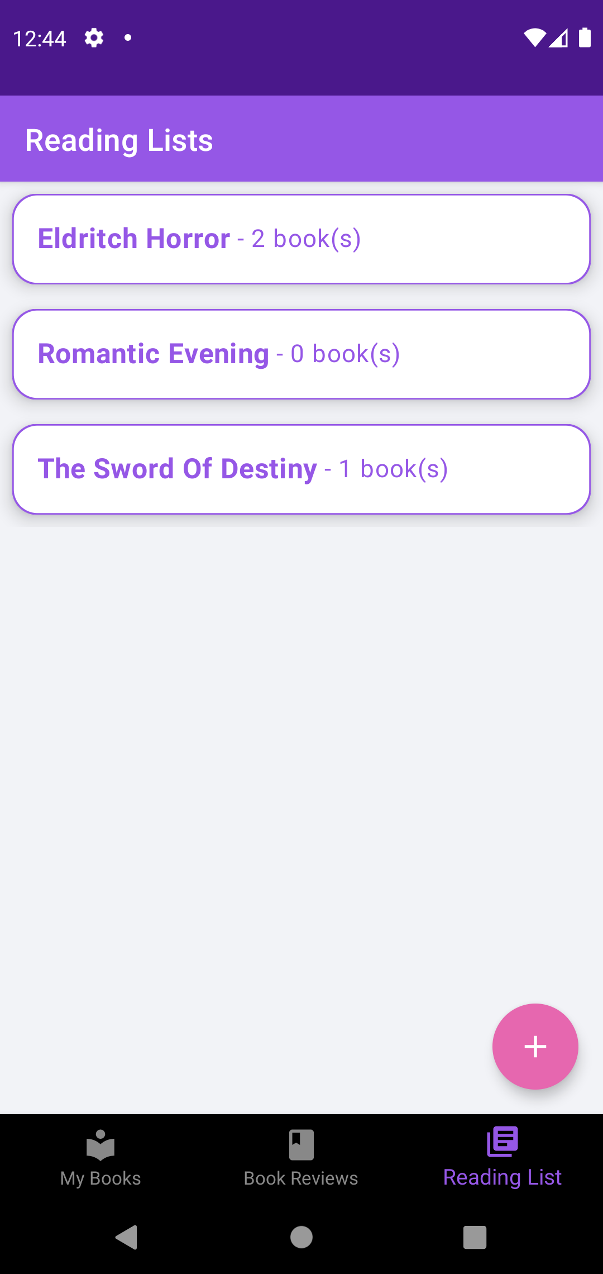
Without observing the state properties
Add list

Slide 52
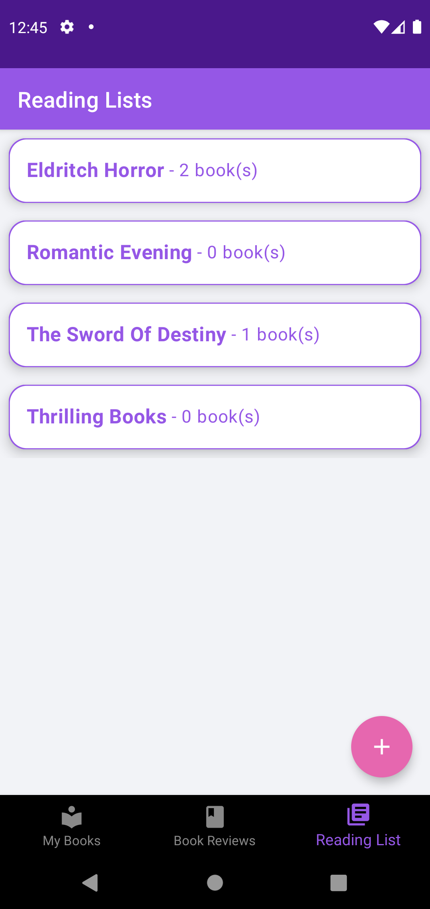
Using remember() for list items
Add list

Slide 53
What happens when state changes?

Slide 54
State Handling
State tends to change
If the state changes, the UI re-draws itself in a smart way, applying minimal changes to match the new state.
This process is called recomposition.

Slide 55
Container state
Header state
List data state

Slide 56
Container - no changes
Header - no changes
List state - changed

Slide 57
Container - doesn’t re-draw
Header - doesn’t re-draw
List - recomposed

Slide 58
Compose is pretty big!
Here are the main items to remember
Build your UI based on state: represent the state within the UI. If the state changes, the UI reflects that.
Start small: You can slowly integrate Compose in your XML powered apps. When building components, deconstruct them into smaller parts.

Slide 59
Resources
Everything you need to check out to master Compose
GitHub repo example
Jetpack Compose course
Ping me if you have any questions!

Slide 60
Questions?

Slide 61
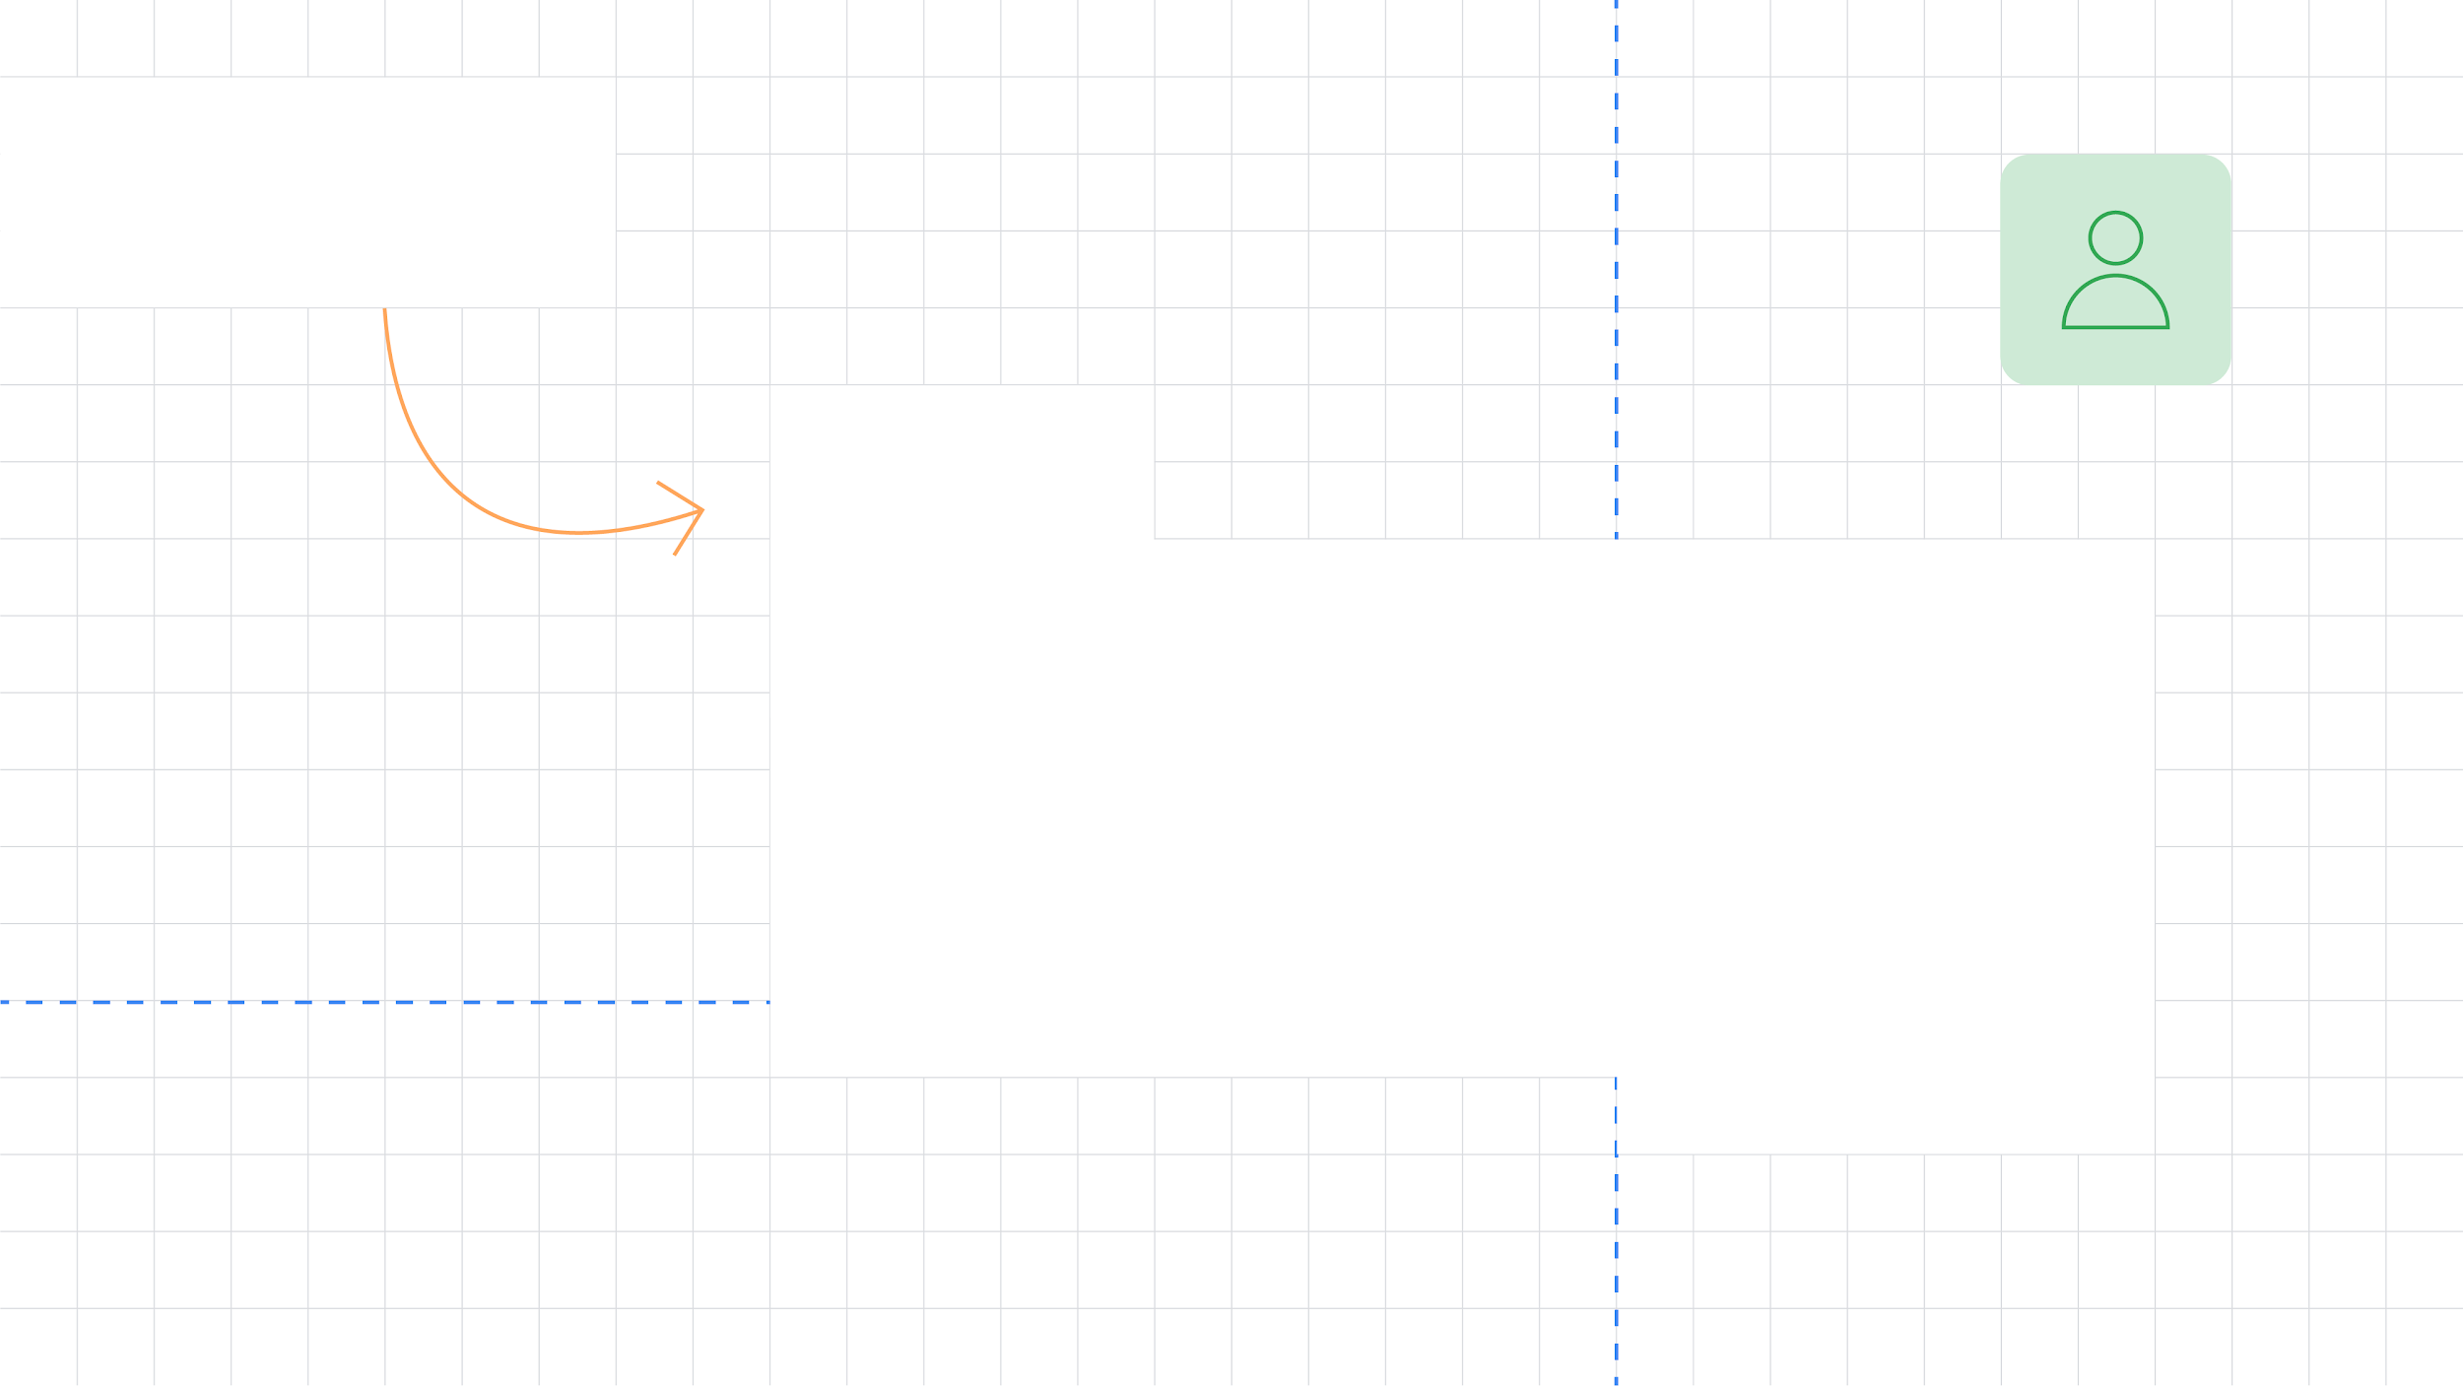
Thank You!

